Slide 1
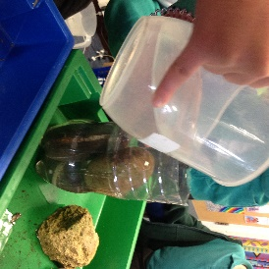
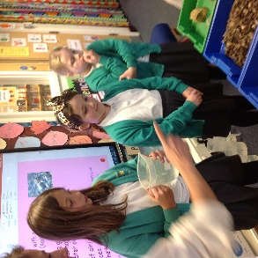
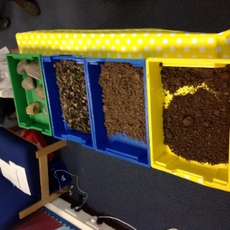
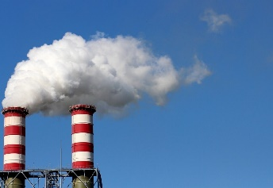
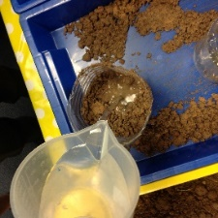
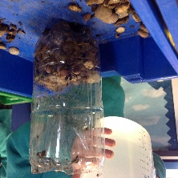
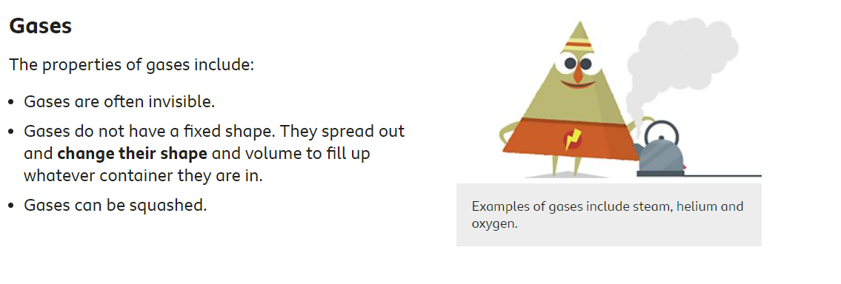
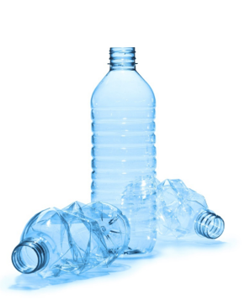
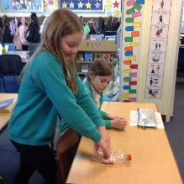
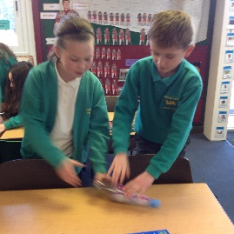
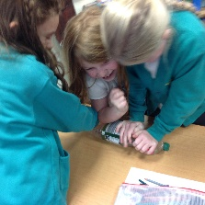
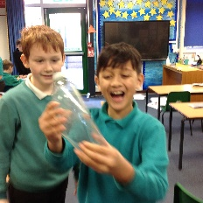
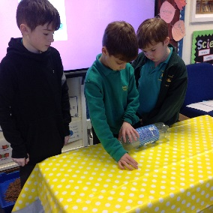
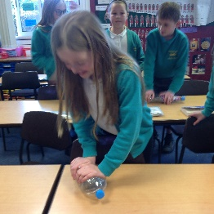
Wednesday 12Th January 2022
States of Matter Lesson 2
Experiment 2
What is a gas?
Walt: To explore and identify gases as one of the states of matter.
We discussed different types of gases in the environment.
We named different gases around us and what they were used for?
Experiment 1: We discussed what a plastic bottle consisted of. We discussed how it could be filled with gas.
Prediction:
We predicted what we think would happen?
With the lid tightly screwed on we tried to try and quash it flat?
.
We discussed gases that are good for the planet and those that are harmful?
We used containers with a variety of solids in containers ( stones, pebbles and gravel sand, and soil)
With a magnifying glass we, investigated what happens as we slowly pour water over them.
Questions we considered
Do Bubbles of air/gas escape as water fills the spaces.
Where do the bubbles come from?
Conclusions:
“Today I noticed that the closer the object the more it produced bubbles” Charlotte.
“I think that the bigger the air pockets the bigger the bubbles produced because the air pockets are bigger” Lottie
“I think the air is pushing down and is being trapped in the water and then it pushes out and forms bubbles. Zach
We then predicted what would
happened when the lid came off?
We then talked about how the bottle was able to flatten when the lid was off.

