Slide 1

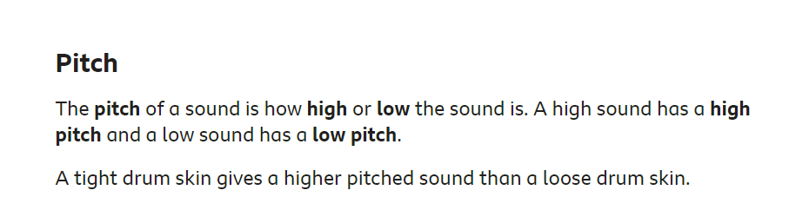
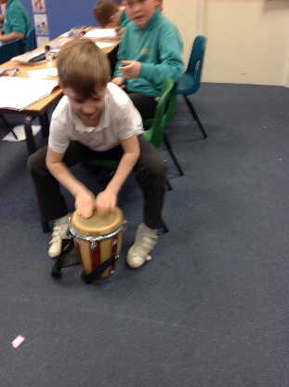
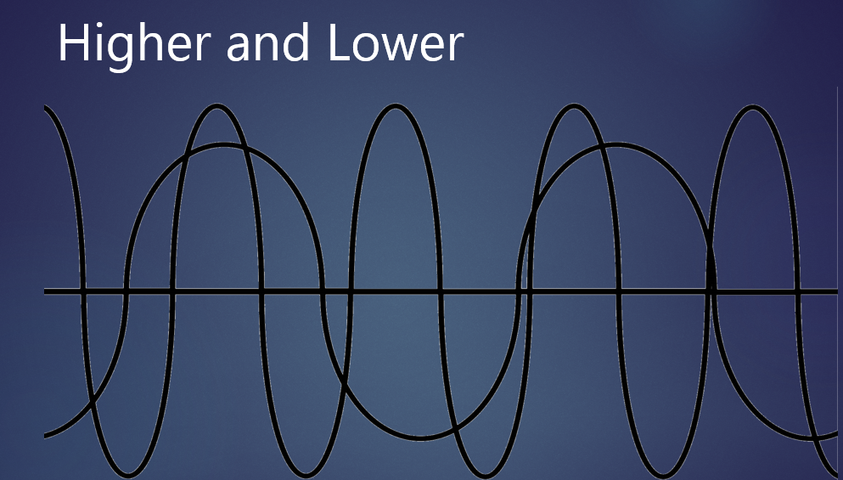
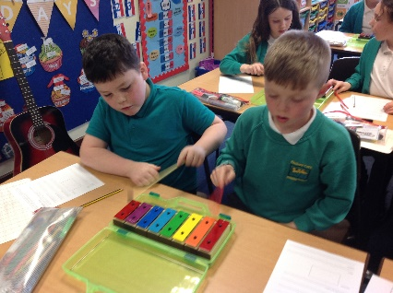
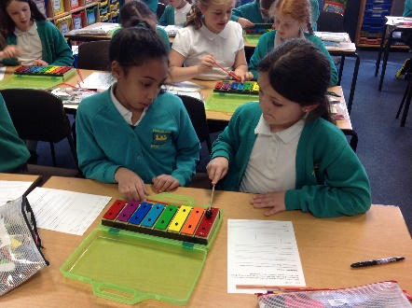
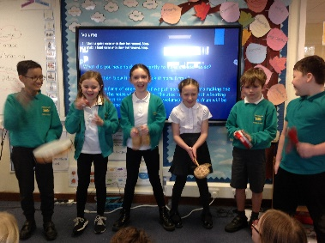
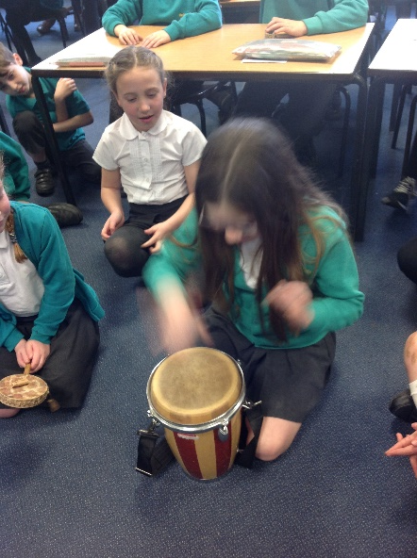
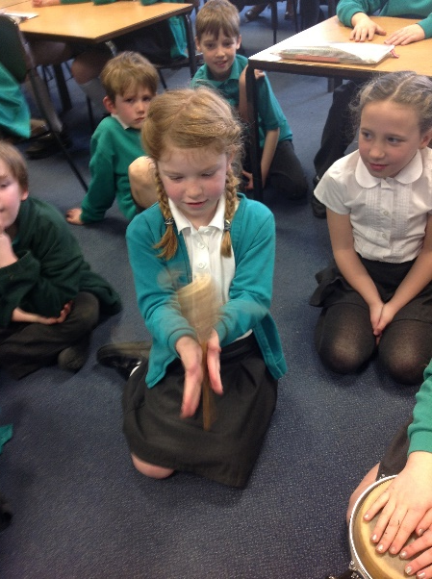
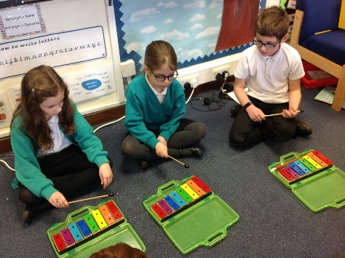
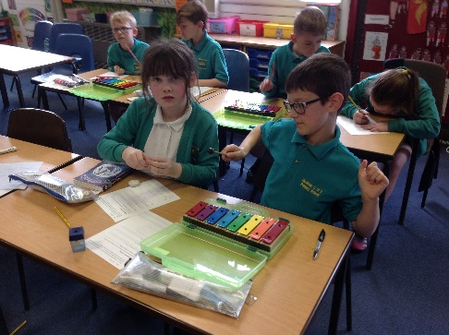
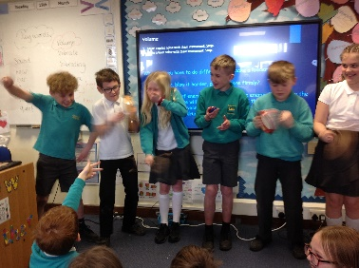
Wednesday 15th March 2022
Sound Lesson 3
Walt: To notice patterns between the pitch and volume of a sound and the features of the object that produced it. To use understanding of pitch and volume to answer questions about soundwaves
We found out:
Sound is a form of energy and if we put more energy into making the noise then the noise will be louder. The size of the object vibrating will also affect the volume (amplitude/volume) – a large drum will be louder than a small drum.
We discussed:
Pitch and Volume
We tested pitch and volume:

