Slide 1
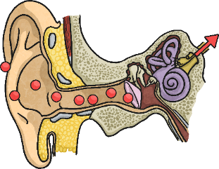
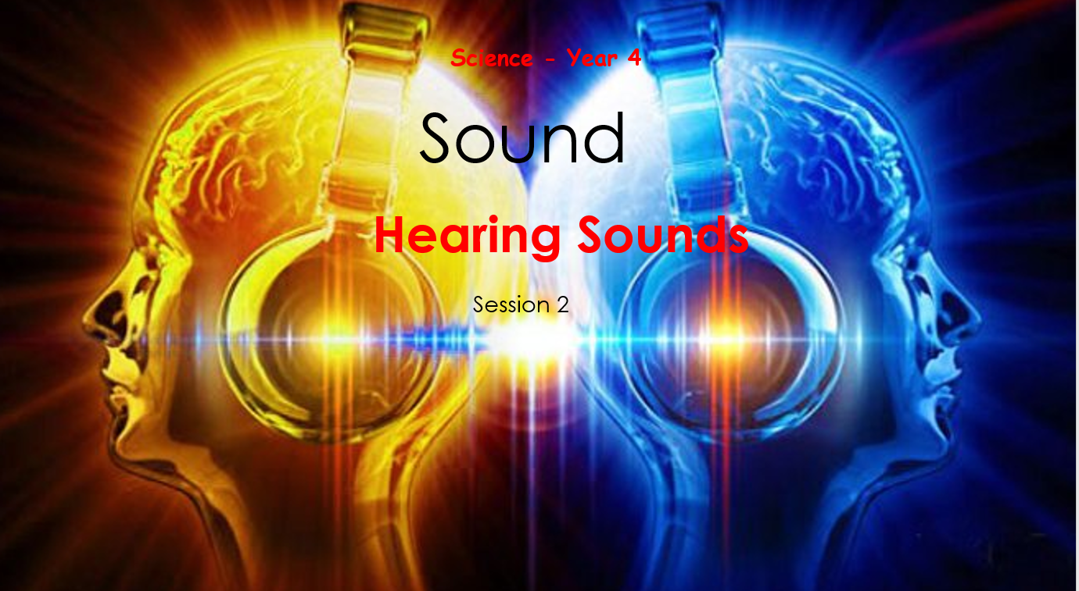
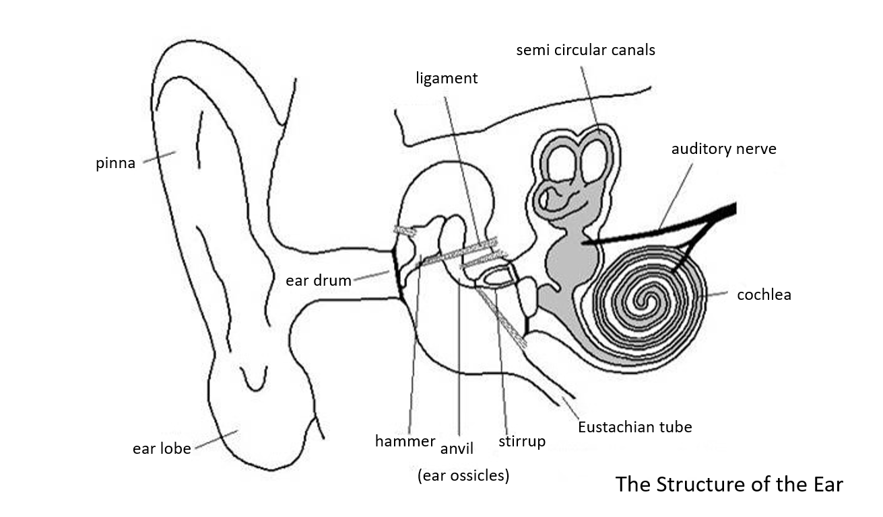
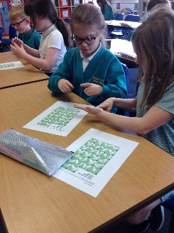
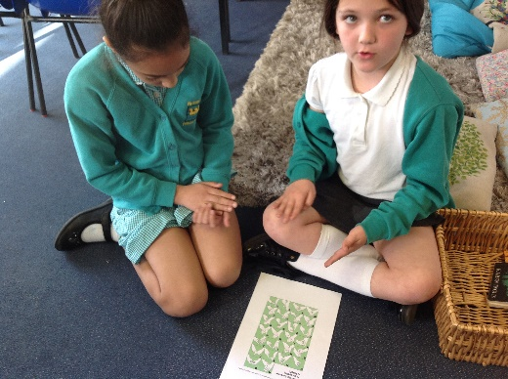
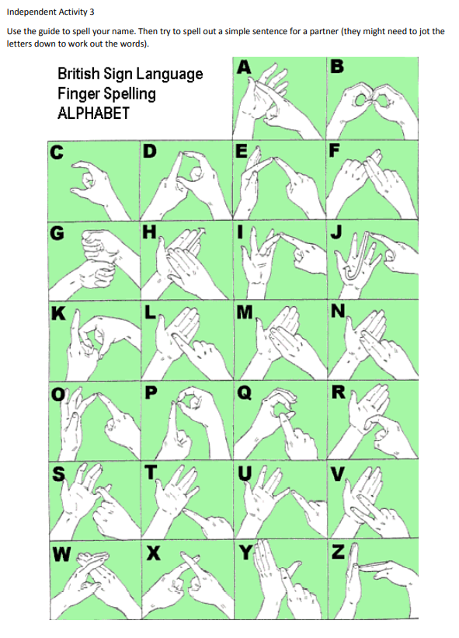
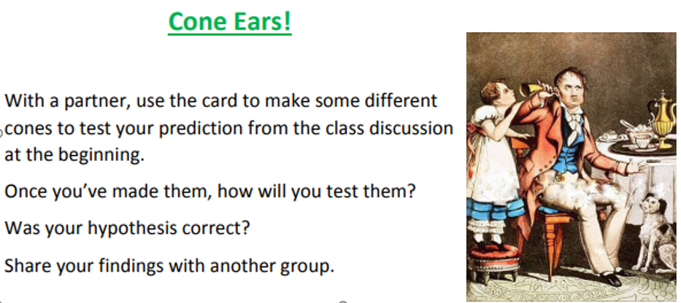
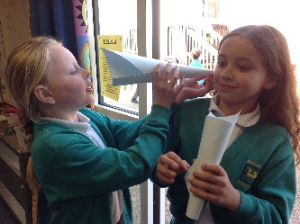
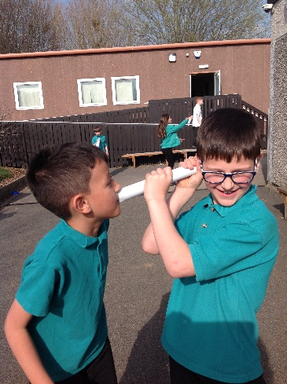
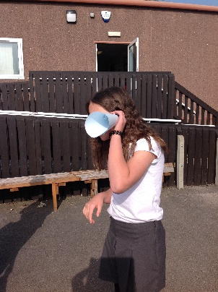
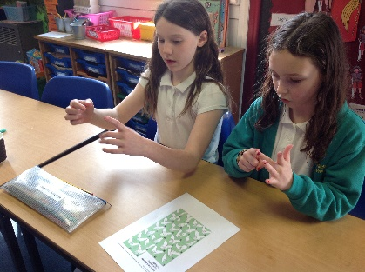
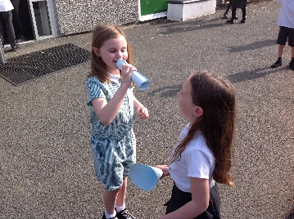
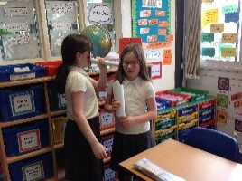
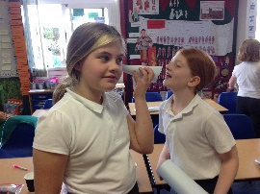
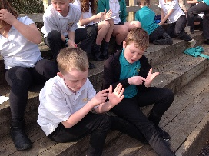
Wednesday 22nd March 2022
Sound Lesson 4
Walt:
To identify how sounds are made, and how some are associated with something vibrating
To recognise that vibrations from sounds travel through a medium to the ear
Sounds get quieter as the distance between the sound source and your ear increases.
Sounds travel as vibrations. As the sound waves travel, the particles of whatever they are travelling through vibrate, or move quickly on the spot. The further the vibrations travel, the more they spread out. As they spread out through more and more particles, the vibrations become smaller and smaller. This causes the sound to get quieter and quieter.
Think of dropping a leaf into a pond. The very first ripples directly around the leaf will be very large, but as the ripples spread out across the pond, they will get smaller and smaller until eventually they disappear.
This is why sounds get quieter and quieter as you move further away from the source, until you eventually can't hear the sound at all.
We discussed:
Why is it important for many animals to hear sounds clearly and to know where the sound is coming from?
We learnt to use
sign language:
We looked at the parts of the ear
We tested:

