Slide 1
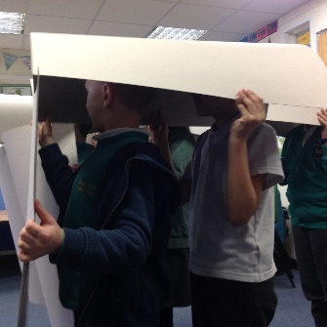
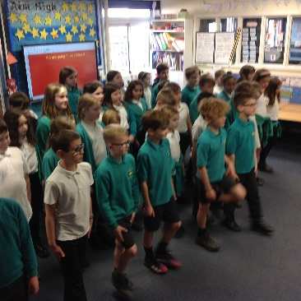
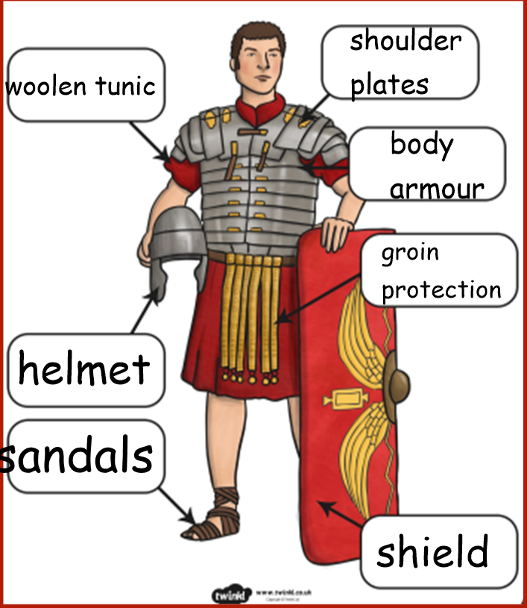
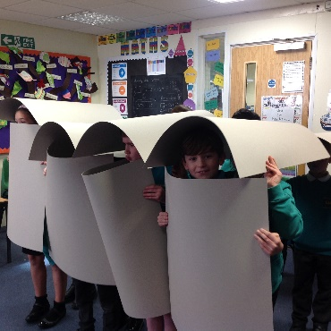
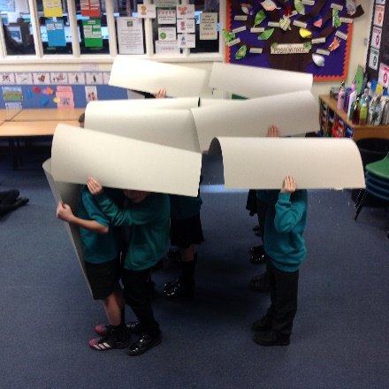
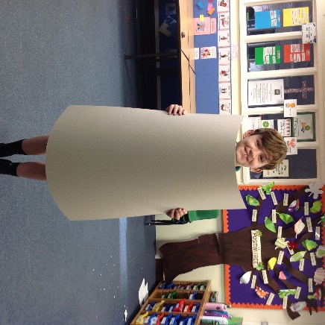
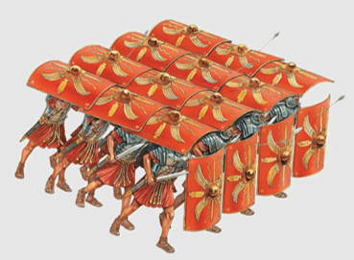
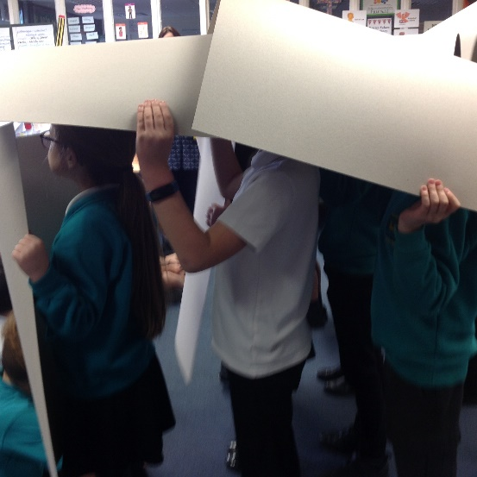
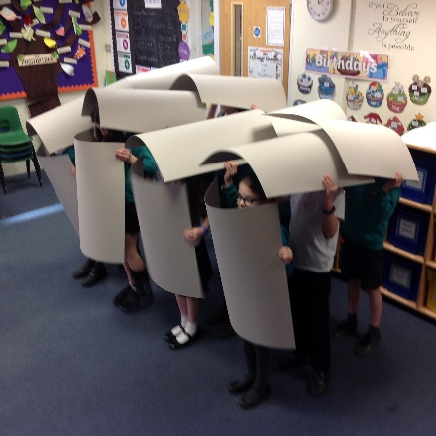
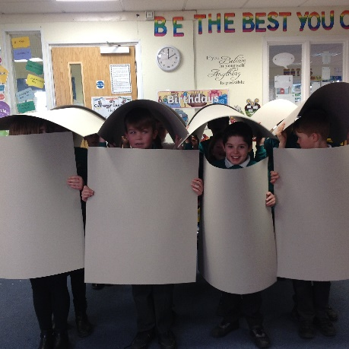
Tuesday 1st February 2022
Roman Solider
WALT: How did the Roman Army work?
One of the most famous formations that the Roman army used was called 'Testudo' or 'The Tortoise!'. The soldiers surrounded themselves entirely in shields which acted like a giant tortoise shell to protect them from arrows and other weapons.
In groups
We formed a Roman Army
and marched in formation.

