Slide 1
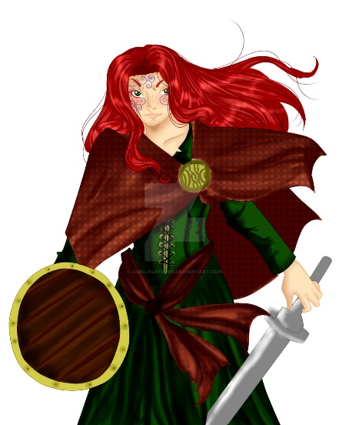
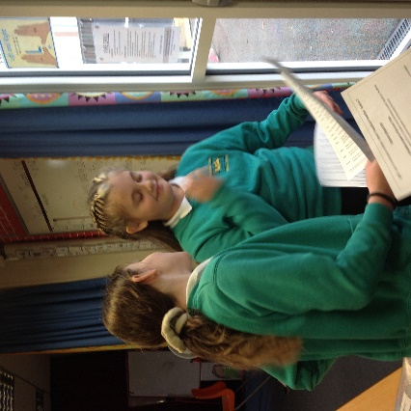
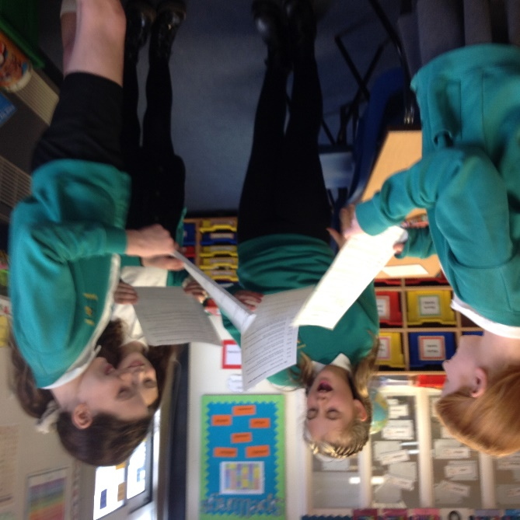
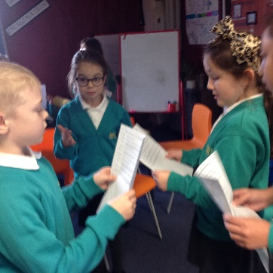
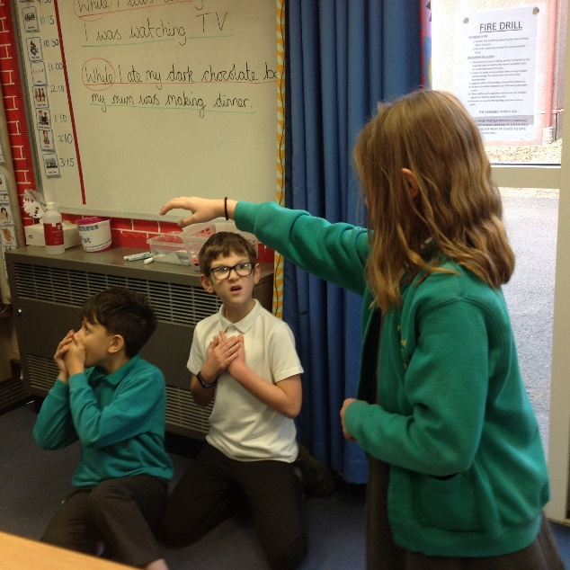
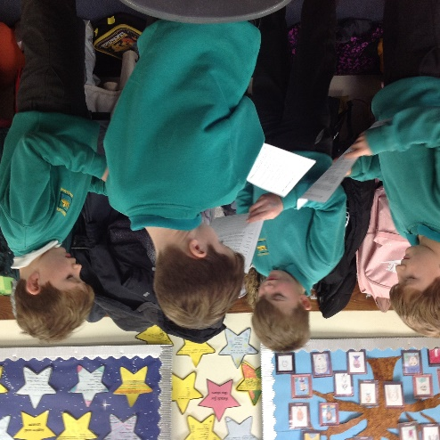
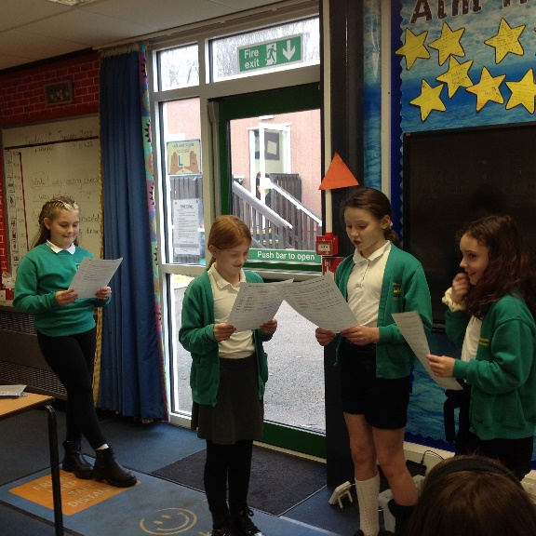
Tuesday 11th January 2022
Drama
Boudicca How did Boudicca fight?
WALT: to use drama to understand why Boudicca fought the Romans
We research and watch videos about Boudicca. We discussed why she was important figure and why she invaded the Roman towns of Colchester, London and St. Albans.
In groups
We discussed what happened and how we could represent this through drama.

