Slide 1


SEND Information Report
Fleckney C of E Primary School
2025 – 2026
Drafted by: Mrs Jennifer Goode (SENDCo) October 2025
Review due: October 2026

Slide 2

Our Christian School Vision
‘Let your light shine’
Matthew 5:16
Be the best that you can be!
Fleckney Church of England Primary School is a place where kindness, compassion and respect are at the heart of everything we do. We aspire for everyone to thrive, flourish, and achieve our full potential in every aspect of school life. Through our Christian values, we nurture self-confidence, resilience and a sense of community so that we have an understanding of our place and ourselves in the wider world.

Slide 3

Welcome
Welcome to our SEN information report which is part of the Leicestershire Local Offer for Learners with special needs. This Mainstream school setting aims to ensure the social and academic inclusion of all its children and to provide a broad and balanced school subjects at an appropriate level through which they will acquire the basic skills and attitudes to meet new challenges with confidence.

Slide 4

Our School Building
The school is fully compliant with DDA requirements.
The main school is on one level with easy access, double doors, wall handles and ramps.
The annexed school building is two levels with a lift to ease access to the top level.
There are five disabled toilets and changing facilities.

Slide 5

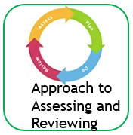













Contents

Slide 6

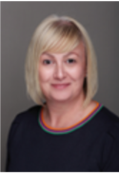
Contacts
Fleckney C of E Primary School
Batchelor Road,
Fleckney.
Leicestershire.
LE8 8BE
Telephone number: 0116 2402288
Name of Head teacher: Mr J Richards
Name of SENDCo: Mrs J Goode fleckneyprimary@Fleckney.leics.sch.uk
Website address: www.fleckney.leics.sch.uk
Age range: 4-11
Date of last inspection: 6th and 7th February 2024
Outcome of last inspection: Good
Our links to policies which relate to SEND: Policies
Mr Richards
Head teacher
Mrs Goode
SENDCo
Contents

Slide 7
Our approach to assessing and reviewing
At Fleckney C of E Primary School, we embrace the fact that every child is different, and therefore, the educational need of every child is different; this is certainly the case for children with extra learning needs.
If you have any concerns regarding your child’s progress or well-being, then please speak to your child’s class teacher, in the first instance, or Mrs. Jennifer Goode (SENDCo) to discuss your concerns.
Please see next page for our explanation of the SEND Process at Fleckney.
Next page

Slide 8
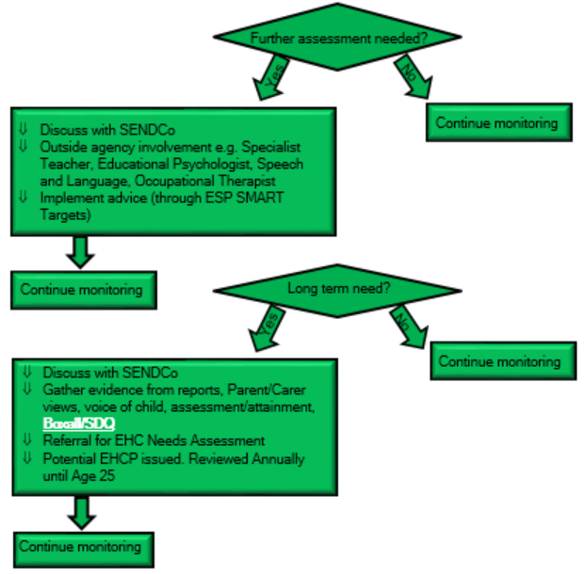
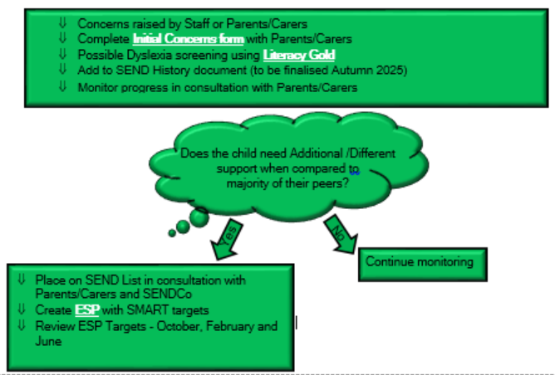

Our approach to assessing and reviewing
Here is our process for identification, assessment and monitoring of SEND at Fleckney C of E Primary School:

Slide 9
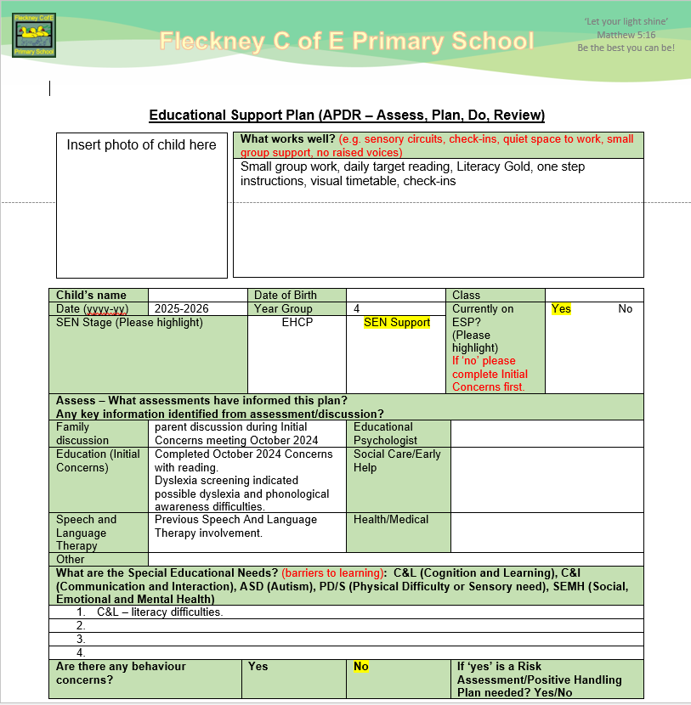
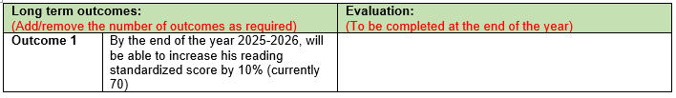
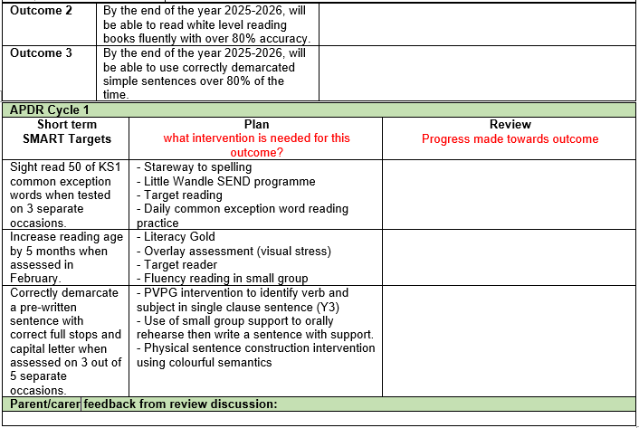

Example Education Support Plan

Slide 10
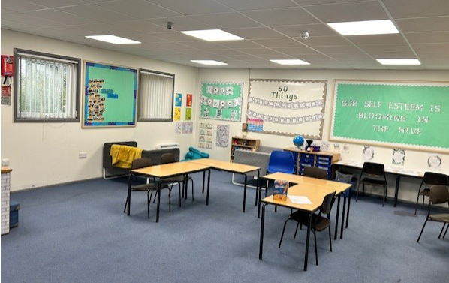
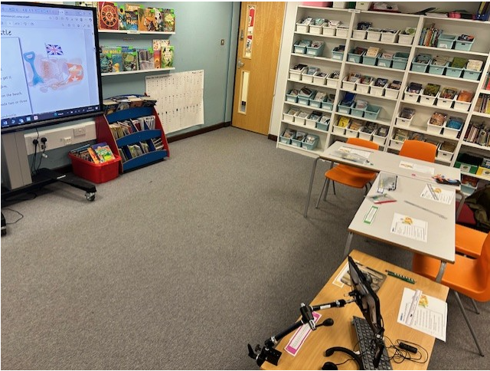
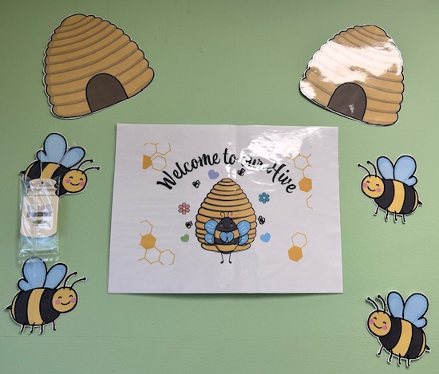

The ‘Hive’ and ‘Orchard Room’
At Fleckney C of E Primary, we are committed to supporting children who may find the classroom a difficult place to be or are learning at a level well below age related expectations.
We have created two on-site provisions to support these children:
The Hive SEMH Provision
Social, Emotional and Mental Health
Orchard Room C&L Provision
Cognition and Learning

Slide 11

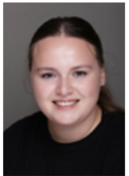




Wellbeing Support
We provide wellbeing support for all children who require intervention for: anxiety, self-esteem, social communication, emotional regulation.
Mrs Dodwell
Miss Freeman
Miss Tribe
Mrs Cordiner
Mrs French
The ‘Hive’ SEMH Teachers

Slide 12
What is SEND?
The Code of Practice 2014 defines SEND as follows:
“A child or young person has SEN if they have a learning difficulty or a disability which calls for special education support to be made for him or her. A child of compulsory school age or a young person has a learning difficulty if he or she:
has a significantly greater difficulty in learning than the majority of others the same age, or has a disability which prevents or hinders him or her from making use of facilities of a kind generally provided for others of the same age in regular schools or regular post-16s institutions.”
Signs that we might look for?
Working below the expected level
Needing more time to complete activities in class or at home
Needing extra equipment or tools to help learning

Slide 13
The Role of SENDCo
Must be a qualified teacher working at the school.
Must have achieved a postgraduate National Award in SEN Coordination/NPQ in SEN Coordination.
Oversee the day-to-day operation of the SEND policy.
Coordinate support for children.
Liaise with parents of children with SEND support.
Liaise with Early Years providers, next phase settings and outside agencies.
Contact details can be found in ‘Contacts’

Slide 14
3 Waves of Inclusion
Waves of Provision at Fleckney C of E Primary School
A graduated approach: All pupils will be provided with high quality teaching that is differentiated to meet the diverse needs of all learners.
There are 3 stages known as ‘waves’ that outline the provision that we provide for our pupils.
Wave 1 | Wave 2 | Wave 3
Wave 1 is the effective inclusion of all pupils in high-quality teaching. Such teaching will, for example, be based on clear objectives that are shared with the children and returned to at the end of the lesson; retrieval practice; carefully explained new vocabulary; use of lively, interactive teaching styles that make maximum use of visual and kinaesthetic as well as auditory/verbal learning. Approaches like these are the best way to reduce, from the start, the number of children who need extra help with their learning or behaviour. | Wave 2 is a specific, additional and time-limited intervention provided for some children who need help to accelerate their progress to enable them to work at or above age-related expectations. Wave 2 interventions are often targeted at a group of children with similar needs. Initial concerns form may be completed. | Wave 3 is targeted provision for a minority of children where it is necessary to provide highly tailored intervention to accelerate progress or enable children to achieve their potential. This may include one to one or specialist interventions. Educational Support Plan in place for long/short term targets/outcomes.

Slide 15

Needs we Support at Fleckney
We provide support for the following Special Educational Needs:
Communication and Interaction (C&I) | Cognition and Learning (C&L) | Social, Emotional and Mental Health (SEMH) | Sensory and Physical (Sens/Phys)
Speech, language and communication needs Autism (ASD) | Moderate Learning Difficulties (MLD) Severe Learning Difficulties (SLD) Specific Learning Difficulties (SpLD) [Dyslexia, Dyscalculia, Developmental Coordination Difficulties – DCD] | Attention Deficit Disorder (ADD) Attention Deficit Hyperactivity Disorder (ADHD) Anxiety, depression, emotional dysregulation, trauma | Hearing Impairment (HI) Visual Impairment (VI) Physical Disability (PD)

Slide 16
How we Support at Fleckney C of E Primary
Additional support can mean that the child will receive small group support in lessons, withdrawal from lessons/certain assemblies for extra help or use of aids which will help their learning. If a child potentially needs extra support, the class teacher will inform the SENDCo and the APDR cycle will begin with checking progress and evidence gathering.
Access arrangements can also be made for public examinations. Access arrangements may be appropriate for a child:
with an EHCP as described in the SEND code of practice;
for whom support is being made in school and/or whose learning difficulty or disability significantly affects their ability to access the tests;
who requires alternative special test help because of a disability (which may or may not give rise to a special educational need);
who is unable to sit and work for a long period because of a disability or because of behavioural, emotional or social difficulties; or
with EAL and who has limited fluency in English.
Further examples of special test help are below. A full list of special test help and information about each one is available on the DfE's website.

Slide 17
How we involve parents/carers
At Fleckney C of E Primary School, we believe that it is vital to work in partnership with parents/carers.
We have a home-school agreement, which clearly sets out what we will do to support as well as what parents/carers can do at home to support their child.
These are the opportunities for you to discuss any concerns/progress with your child’s class teacher.
(This is not an exhaustive list – appointments can be made throughout the year via the school office)
Initial Concerns
Parents evenings
(September/January)
ESP discussions
[Educational Support Plans]
(Oct/Feb/June)
Contact via email to Year group
EHCP Annual Reviews/ECH Needs Assessment Requests

Slide 18

How we involve pupils
I always take part in Pupil Voice work for the Annual Review of my EHCP
I can talk to Wellbeing Support, my teacher or Support staff about my learning
I give my Pupil Voice when an ECH Needs Assessment is requested
I have an ESP so that everyone who helps me can see what I’m working on and how to support me.
Child
Centred
When someone from outside school comes to work with me, they always ask what I need to help me to learn
I can work in a small group for more help

Slide 19
Supporting Transition
Transition begins at the very start of Year 6
Transfer reviews for EHCPs are arranged to be completed before the end of September. We try our best to arrange for the child’s next school to be involved in the meeting.
Along with enhanced visits to the secondary schools, we meet with the SENDCos of each secondary school to pass on information about your child and advise the support they will need.
In the Summer term of Year 6, a transition intervention is available for any children we feel need a bit of reassurance, this is in collaboration with parents.
Finally, the children get to meet staff from the secondary schools and are invited to an open evening at their new school.

Slide 20
Staff Training
Our staff receive regular training on SEND including:
  Literacy Gold
  Epipen and Asthma
  Makaton
  Keeping Children Safe in Education/ Safeguarding
  Selective Mutism
  PINS (Partnership for Inclusion of Neurodiversity in Schools)
  Autism Education Trust- Making Sense of Autism, Good Autism Practice, Leading Good Autism Practice
  Emotional Wellbeing
  Drawing and Talking
  Structured Teaching
  Autism in the Early Years

Slide 21

How we support with extra-curricular activities
Fleckney C of E Primary School has a wide range of after-school activities from Art to Sport. All children within the school, regardless of ability and/or SEND needs or Disabilities are entitled to attend.
We also have access to a Breakfast and After-School club, which is independently run on the premises.
The After School Club contact: Suzanne Bottrill
07791 259905
foscle8@yahoo.co.uk
We pride ourselves on an inclusive view towards residential visits. We work with parents to ensure that, if a child with SEND would like to attend, we will do our best to make that happen by ensuring if any changes are needed, they will be made to enable all children to get the most out of the visit.
* this is subject to the residential centres being able to accommodate

Slide 22
External Agencies
These are some of the outside agencies that we might work with:
Leicestershire Educational Psychology Service
Early Help – Children and Family Wellbeing Service
NHS services – Paediatrician, Occupational Therapy, Physiotherapy, Speech and Language
Visual Impairment Team
Autism Outreach Team
Hearing Impairment Team
Virtual School – supporting Looked After Children/Post Adoption/Previously Looked After Children
Click here for more contacts

Slide 23
Complaints
We strive to provide a good education for all our children. The Headteacher and staff work very hard to build positive relationships with all parents and carers. However, the school is obliged to have procedures in place in case there are complaints by parents or guardians. The following policy sets out the procedures that the school follows in such cases.
We deal with all complaints in accordance with procedures laid down by the LA. If the school itself cannot resolve a complaint, those concerned can refer the matter to the LA.
If a parent is concerned about anything to do with the education that we are providing at our school, they should, in the first instance, discuss the matter with their child's class teacher. In our experience, most matters of concern can be resolved positively in this way. All teachers work very hard to ensure that each child is happy at school, and is making good progress; they naturally want to know if there is a problem, so that they can take action before it seriously affects the child's progress.

Slide 24
Complaints
Where parents or carers of a child with extra learning help feel that a situation has not been resolved through contact with the class teacher, or that their concern is of a sufficiently serious nature, they should make an appointment to discuss it with the SENDCo or Headteacher.
The SENDCo/Headteacher considers any such complaint very seriously and investigates each case thoroughly. Most complaints are normally resolved by this stage.
Should any parents or carers have a complaint about the Headteacher, they should first make an informal approach to one of the members of the governing body, who is obliged to investigate it. The governor in question will do all s/he can to resolve the issue through a dialogue with the school, but if parents or carers are unhappy with the outcome, they can make a formal complaint by making it in writing addressed to the Chair of Governors:
Mr Gareth Robinson
email: grobinson2@fleckney.leics.sch.uk

Slide 25
Frequently Asked Questions
How will teachers know what my child needs? We have an excellent transition process which will ensure that all your child’s needs will be passed on to any future class teacher. | How do you support dyslexic learners? We can screen for dyslexia and visual stress to give an indication of dyslexia traits (and interventions which would support) and whether a coloured overlay would help.
How will I know how my child is getting on? Aside from the parents evenings (usually around September and January), you will receive an Educational Support Plan (ESP) with SMART targets and an individualised plan for support. | Who should I contact if I am concerned about my child’s Special Educational Needs? First, contact your child’s class teacher, who can discuss how your child presents in school. If needed, you will then be directed to the SENDCo for more support and offers of outside agency support.
Will my child have a 1:1 Learning Support Assistant? We are unable to provide 1:1 support for all pupils with SEND. Your child may have 1:1 intervention/support throughout the week and they will be given a Keyworker for a point of contact. | What do I do if I think my child may have ADHD or Autism? First, speak to your child’s class teacher who may consult with the SENDCo. Make an appointment with your GP to discuss your concerns and ask to be referred via ‘Right to Choose’ for investigation into Neurodivergence. Click here for more information: Right to Choose - ADHD UK
How will teaching be adapted to support my child? We pride ourselves on getting to know your child and know what strategies will help them to feel safe in school and learn. We create ESPs from scratch each year to meet the individual needs of your child. | If you have any concerns or any questions we haven’t answered, please email Mrs Goode (SENDCo) via the school office: fleckneyprimary@fleckney.leics.sch.uk

